Slide 1
SQL Training
Intermediate

Slide 2
Contents
Intermediate SQL Skills
With – Common Table Expression
Correlated subquery
Except and Intercept
Import/Export Data using SQL wizard
Performance Enhancement
WHERE Clause
EXISTS, JOIN, IN
DISTINCT and GROUP BY
UPDATE
COALESCE
Sub-query in JOIN

Slide 3
Contents
Intermediate SQL Skills
With – Common Table Expression
Correlated subquery
Except and Intercept
Import/Export Data using SQL wizard
Performance Enhancement
WHERE Clause
EXISTS, JOIN, IN
DISTINCT and GROUP BY
UPDATE
COALESCE
Sub-query in JOIN

Slide 4
WITH common_table_expression
Specifies a temporary named result set, known as a common table expression (CTE). This is derived from a simple query and defined within the execution scope of a SELECT, INSERT, UPDATE, or DELETE statement. This clause can also be used in a CREATE VIEW statement as part of its defining SELECT statement. A common table expression can include references to itself. This is referred to as a recursive common table expression.
Example1: With makes query easy to read
WITH DirReps (Manager, DirectReports) AS
(
SELECT ManagerID, COUNT(*) AS DirectReports
FROM HumanResources.Employee
GROUP BY ManagerID
)
SELECT AVG(DirectReports) AS [Average Number of Direct Reports]
FROM DirReps
WHERE DirectReports>= 2 ;

Slide 5
WITH common_table_expression
Example2: Referencing a common table expression more than one time
WITH Sales_CTE (SalesPersonID, NumberOfOrders, MaxDate)
AS
(
SELECT SalesPersonID, COUNT(*), MAX(OrderDate)
FROM Sales.SalesOrderHeader
GROUP BY SalesPersonID
)
SELECT E.EmployeeID, OS.NumberOfOrders, OS.MaxDate,
E.ManagerID, OM.NumberOfOrders, OM.MaxDate
FROM HumanResources.Employee AS E
JOIN Sales_CTE AS OS
ON E.EmployeeID = OS.SalesPersonID
LEFT OUTER JOIN Sales_CTE AS OM
ON E.ManagerID = OM.SalesPersonID
ORDER BY E.EmployeeID;
CTE referred twice

Slide 6
Contents
Intermediate SQL Skills
With – Common Table Expression
Correlated subquery
Except and Intercept
Import/Export Data using SQL wizard
Performance Enhancement
WHERE Clause
EXISTS, JOIN, IN
DISTINCT and GROUP BY
UPDATE
COALESCE
Sub-query in JOIN

Slide 7
Correlated Subquery
Definition:
A correlated subquery is a SELECT statement nested inside another T-SQL statement, which contains a reference to one or more columns in the outer query.
The correlated subquery can be said to be dependent on the outer query. A correlated subquery will return a syntax errors if it is run by itself.
How does it work?
A correlated subquery will be executed many times while processing the T-SQL statement that contains the correlated subquery.
The correlated subquery will be run once for each candidate row selected by the outer query. The outer query columns, referenced in the correlated subquery, are replaced with values from the candidate row prior to each execution.
Depending on the results of the execution of the correlated subquery, it will determine if the row of the outer query is returned in the final result set.
Example:
SELECT *
FROM T_Doctors
WHERE EXISTS (SELECT DOCID FROM T_Calls
WHERE (T_Doctors.DOCID = T_Calls.DOCID))

Slide 8
Correlated Subquery: Continued
Using Correlated Subquery With Select
The code below is another example that uses a correlated subquery in the WHERE clause to display the top two customers, based on the dollar amount associated with their orders, per region. You might want to perform a query like this so you can reward these customers, since they buy the most per region.
SELECT CompanyName, ContactName, Address, City, Country, PostalCode
FROM Northwind.dbo.Customers AS OuterC
WHERE (CustomerID exists
(SELECT TOP (2) InnerC.CustomerId
FROM Northwind.dbo.[Order Details] AS OD INNER JOIN
Northwind.dbo.Orders AS O ON OD.OrderId = O.OrderID INNER JOIN
Northwind.dbo.Customers AS InnerC ON O.CustomerID = InnerC.CustomerId
WHERE (Region = OuterC.Region)
GROUP BY Region, InnerC.CustomerId
ORDER BY SUM((UnitPrice * Quantity) * (1 - Discount)) DESC))
ORDER BY Region

Slide 9
Correlated Subquery: Continued
Using Correlated Subquery With Having
An organization advertise to your customers that if each order they place, during the year, is over $750 you will provide them a rebate at the end of the year at the rate of $75 per order they place. Below is an example of how to calculate the rebate amount.
SELECT C.CustomerID, COUNT(*) * 75 AS Rebate
FROM Northwind.DBO.Customers AS C INNER JOIN
Northwind.DBO.Orders AS O ON c.CustomerID = O.CustomerID
WHERE (DATEPART(yy, OrderDate) = '1998')
GROUP BY C.CustomerID
HAVING (750 < ALL
(SELECT SUM((UnitPrice * Quantity) * (1 - Discount)) AS Expr1
FROM Northwind.DBO.Orders AS O INNER JOIN
Northwind.DBO.[Order Details] AS OD ON O.OrderID = OD.OrderID
WHERE (CustomerID = C.CustomerId) AND (DATEPART(yy, OrderDate) = '1998')
GROUP BY O.OrderId))

Slide 10
Contents
Intermediate SQL Skills
With – Common Table Expression
Correlated subquery
Except and Intercept
Import/Export Data using SQL wizard
Performance Enhancement
WHERE Clause
EXISTS, JOIN, IN
DISTINCT and GROUP BY
UPDATE
COALESCE
Sub-query in JOIN

Slide 11
EXCEPT and INTERSECT Statement
Returns distinct values by comparing the results of two queries.
EXCEPT returns any distinct values from the left query that are not also found on the right query.
INTERSECT returns any distinct values that are returned by both the query on the left and right sides of the INTERSECT operand.
The basic rules for combining the result sets of two queries that use EXCEPT or INTERSECT are the following:
The number and the order of the columns must be the same in all queries.
The data types must be compatible.
SYNTAX:
{ <query_specification> | ( <query_expression> ) }
{ EXCEPT | INTERSECT }
{ <query_specification> | ( <query_expression> ) }

Slide 12
EXCEPT and INTERSECT Statement: Continued
Consider two tables with following data
TableA has [NULL, NULL, NULL, 1, 2, 2, 2, 3, 4, 4]
TableB has [1, 3, 4, 4]
Except: The following query returns any distinct values from the query to the left of the EXCEPT operand that are not also found on the right query.
SELECT * FROM TableA EXCEPT SELECT * FROM TableB → Return 2
INTERSECT: The following query returns any distinct values that are returned by both the query on the left and right sides of the INTERSECT operand. .
SELECT * FROM TableA INTERSECT SELECT * FROM TableB → Return 1,3,4

Slide 13
Contents
Intermediate SQL Skills
With – Common Table Expression
Correlated subquery
Except and Intercept
Import/Export Data using SQL wizard
Performance Enhancement
WHERE Clause
EXISTS, JOIN, IN
DISTINCT and GROUP BY
UPDATE
COALESCE
Sub-query in JOIN

Slide 14
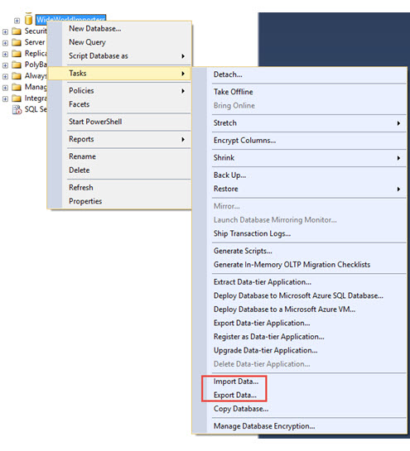
Import/Export Data using SQL wizard
Steps:
In SQL Server Management Studio, connect to an instance of the SQL Server Database Engine.
Expand Databases.
Right-click a database.
Point to Tasks.
Choose to Import Data or Export Data

Slide 15
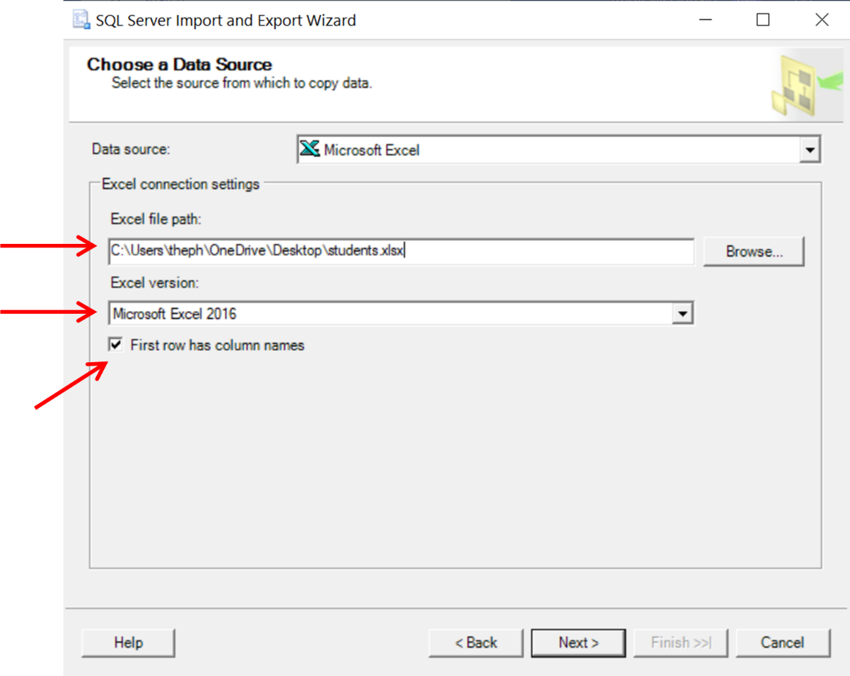
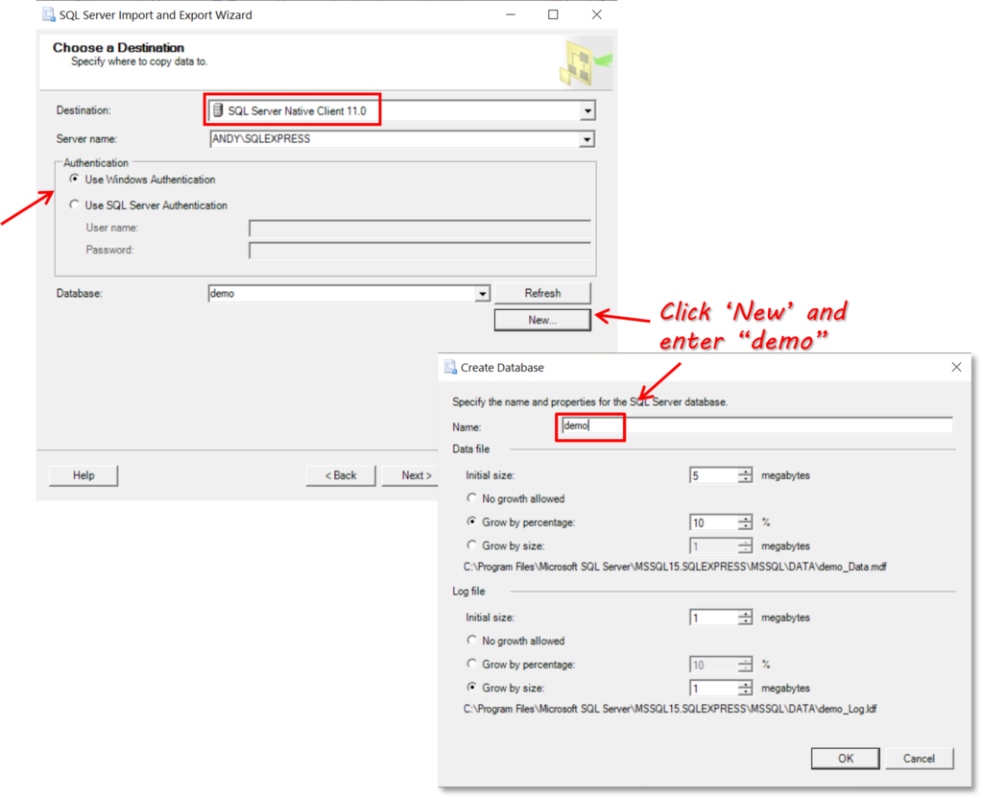
Import/Export Data using SQL wizard
Steps:
Choose Source file
Steps:
Choose destination server/database

Slide 16
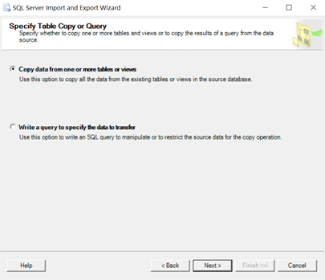
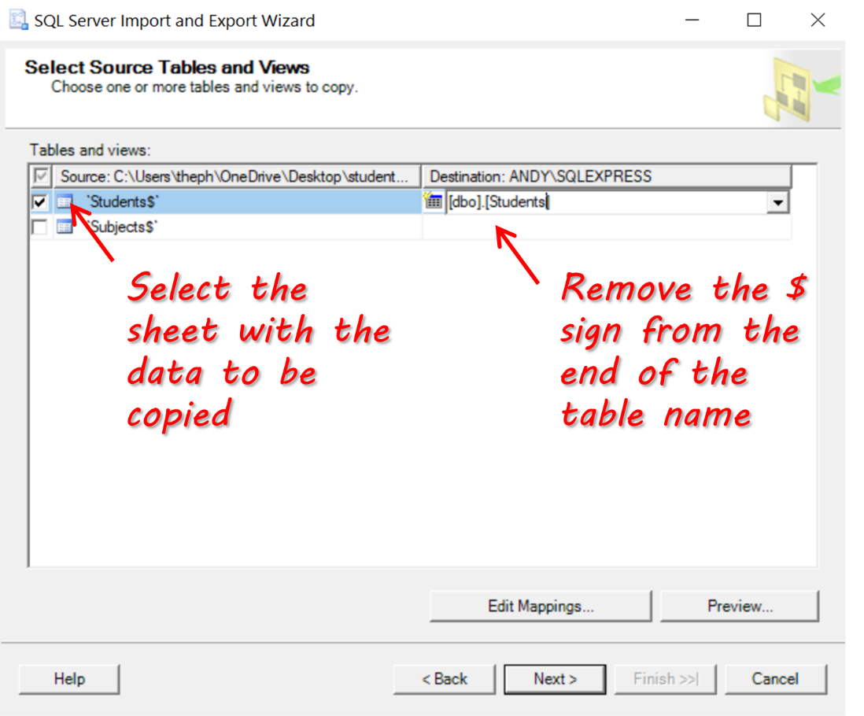
Import/Export Data using SQL wizard
Steps:
Select table copy or query
Copying all the data or a subset of data
Steps:
Select Source Tables and Views
Choose the specific sheet(s) within the workbook that needs to be copied
Re-name the table to be created/Select the table

Slide 17
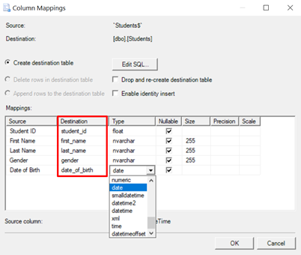
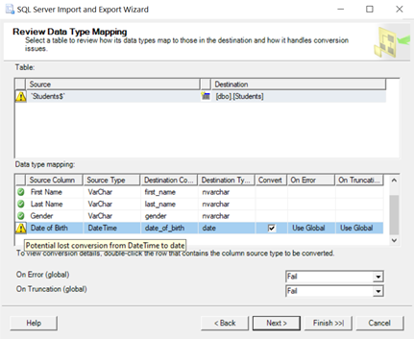
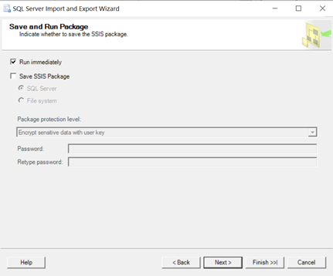
Import/Export Data using SQL wizard
Steps:
Configure the copy operation
Edit column names & column data types
Review the column mapping between source and destination
Run the process to load data
Note: Export operation will involve change in the source and destination (Source will be SQL table and destination will be a file)

Slide 18
Contents
Intermediate SQL Skills
With – Common Table Expression
Correlated subquery
Except and Intercept
Import/Export Data using SQL wizard
Performance Enhancement
WHERE Clause
EXISTS, JOIN, IN
DISTINCT and GROUP BY
UPDATE
COALESCE
Sub-query in JOIN

Slide 19
Performance Enhancement
We have given some of the performance tips throughout the deck. Here you will find a list of some more
In group by and having; try to put “Where” clause instead of “HAVING” because SQL server first gets the rows and then apply an aggregate (which is a complex operation) and then filter it using HAVING. So if we can filter the data, then it has to aggregate less number of rows
Carefully see if you need DISTINCT keyword in your query. It is a very time consuming operation.
In a WHERE clause, the various operators used directly affect how fast a query is run. So in the list of =, <=, >=, <, <, LIKE,<> (left to right is increasing order of execution time). So use “=” as much as possible and “<>” as less as possible
If you use LIKE in your WHERE clause, try to use one or more leading character in the clause, if at all possible. For example, use: LIKE 'm%‘ not: LIKE '%m'
If you use a leading character in your LIKE clause, then the Query Optimizer will use an index to perform the query, speeding performance.
But if the leading character in a LIKE clause is a wildcard, the Query Optimizer will not be able to use an index.

Slide 20
Performance Enhancement: Where Clause
If possible, try to avoid using the SUBSTRING function in your WHERE clauses. Depending on how it is constructed, using the SUBSTRING function can force a table scan instead of allowing the optimizer to use an index (assuming there is one). If the substring you are searching for does not include the first character of the column you are searching for, then a table scan is performed.
If possible, you should avoid using the SUBSTRING function and use the LIKE condition instead, for better performance.
Don’t : WHERE SUBSTRING(column_name,1,1) = 'b'
Do : WHERE column_name LIKE 'b%'
If you decide to make this choice, keep in mind that your like should not place a wildcard in the first position
If you have a WHERE clause that includes expressions connected by two or more AND operators, SQL Server will evaluate them from left to right in the order they are written. This assumes that no parenthesis have been used to change the order of execution. Because of this, you may want to consider one of the following when using AND:
Locate the least likely true AND expression first. This way, if the AND expression is false, the clause will end immediately, saving time.
If both parts of an AND expression are equally likely being false, put the least complex AND expression first. This way, if it is false, less work will have to be done to evaluate the expression.

Slide 21
Contents
Intermediate SQL Skills
With – Common Table Expression
Correlated subquery
Except and Intercept
Import/Export Data using SQL wizard
Performance Enhancement
WHERE Clause
EXISTS, JOIN, IN
DISTINCT and GROUP BY
UPDATE
COALESCE
Sub-query in JOIN

Slide 22
Performance Enhancement: “Exists” is better than “Join” which is better than “In”
It is fairly common request to write a Transact-SQL query to compare a parent table and a child table and find out if there are any parent records that don't have a match in the child table. Generally, there are three ways this can be done:
Using a NOT EXISTS
SELECT a.hdr_key
FROM hdr_tbl a
WHERE NOT EXISTS (SELECT * FROM dtl_tbl b WHERE a.hdr_key = b.hdr_key)
Using a LEFT JOIN
SELECT a.hdr_key
FROM hdr_tbl a
LEFT JOIN dtl_tbl b ON a.hdr_key = b.hdr_key
WHERE b.hdr_key IS NULL
Using a NOT IN
SELECT hdr_key
FROM hdr_tbl
WHERE hdr_key NOT IN (SELECT hdr_key FROM dtl_tbl)
The best performing version through the worst performing version will be from top to bottom, as displayed above. In other words, the NOT EXISTS variation of this query is generally the most efficient.
The indexes found on the tables, along with the number of rows in each table, can influence the results. If you are not sure which variation to try yourself, you can try them all and see which produces the best results in your particular circumstances

Slide 23
Performance Enhancement: Continued
When you have a choice of using the IN or the BETWEEN clauses in your Transact-SQL, you will generally want to use the BETWEEN clause, as it is much more efficient. For example:
Don’t: SELECT customer_number, customer_name
FROM customer
WHERE (customer_number IN (1000, 1001, 1002, 1003, 1004))
Do: SELECT customer_number, customer_name
FROM customer
WHERE (customer_number BETWEEN 1000 AND 1004)
Assuming there is a useful index on customer_number, the Query Optimizer can locate a range of numbers much faster (using BETWEEN) than it can find a series of numbers using the IN clause (which is really just another form of the OR clause).
Instead of using temporary tables, consider using a derived table instead. A derived table is the result of using a SELECT statement in the FROM clause of an existing SELECT statement. By using derived tables instead of temporary tables, you can reduce I/O and boost your application's performance

Slide 24
Contents
Intermediate SQL Skills
With – Common Table Expression
Correlated subquery
Except and Intercept
Import/Export Data using SQL wizard
Performance Enhancement
WHERE Clause
EXISTS, JOIN, IN
DISTINCT and GROUP BY
UPDATE
COALESCE
Sub-query in JOIN

Slide 25
Performance Enhancement: Distinct and Group By
The GROUP BY clause can be used with or without an aggregate function. But if you want optimum performance, don't use the GROUP BY clause without an aggregate function. This is because you can accomplish the same end result by using the DISTINCT option instead, and it is faster.
For example, you could write your query two different ways:
Don’t: SELECT OrderID
FROM [Order Details]
WHERE (UnitPrice > 10)
GROUP BY OrderID
OR
Do: SELECT DISTINCT OrderID
FROM [Order Details]
WHERE (UnitPrice > 10)
Both of the above queries produce the same results, but the second one will use less resources and perform faster

Slide 26
Contents
Intermediate SQL Skills
With – Common Table Expression
Correlated subquery
Except and Intercept
Import/Export Data using SQL wizard
Performance Enhancement
WHERE Clause
EXISTS, JOIN, IN
DISTINCT and GROUP BY
UPDATE
COALESCE
Sub-query in JOIN

Slide 27
Performance Enhancement: Update
Performing UPDATES takes extra resources for SQL Server to perform. When performing an UPDATE, try to do as many of the following recommendations as you can in order to reduce the amount of resources required to perform an UPDATE. The more of the following suggestions you can do, the faster the UPDATE will perform.
If you are Updating a column of a row that has an unique index, try to only update one row at a time.
Try not to change the value of a column that is also the primary key.
When updating VARCHAR columns, try to replace the contents with contents of the same length.
Try to minimize the Updating of tables that have UPDATE triggers.
Try to avoid Updating columns that will be replicated to other databases.
Try to avoid Updating heavily indexed columns.
Try to avoid Updating a column that has a reference in the WHERE clause to the column being updated.

Slide 28
Contents
Intermediate SQL Skills
With – Common Table Expression
Correlated subquery
Except and Intercept
Import/Export Data using SQL wizard
Performance Enhancement
WHERE Clause
EXISTS, JOIN, IN
DISTINCT and GROUP BY
UPDATE
COALESCE
Sub-query in JOIN

Slide 29
Performance Enhancement: COALESCE
Handling the NULL Values Effectively with the COALESCE Function. COALESCE function is used to substitute a default value for a NULL value.
For example,
Don’t: SELECT product_name, price, discount,
(price – CASE WHEN discount IS NOT NULL THEN discountELSE 0 END) AS net_price
FROM products;
Do: SELECT product_name, price, discount,
(price - COALESCE(discount,0)) AS net_price
FROM products;
Read more on this here - https://www.sqltutorial.org/sql-comparison-functions/sql-coalesce/

Slide 30
Contents
Intermediate SQL Skills
With – Common Table Expression
Correlated subquery
Except and Intercept
Import/Export Data using SQL wizard
Performance Enhancement
WHERE Clause
EXISTS, JOIN, IN
DISTINCT and GROUP BY
UPDATE
COALESCE
Sub-query in JOIN

Slide 31
Performance Enhancement: Subquery in Joins
Making joins less complicated using subquery. It's better to reduce table sizes before joining them.
For example,
Don’t: SELECT teams.conference AS conference, players.school_name,
COUNT(1) AS noofplayers
FROM players
JOIN teams
ON teams.school_name = players.school_name
GROUP BY teams.conference, players.school_name;
Do: SELECT teams.conference,
sub.*
FROM (
SELECT players.school_name, COUNT(*) AS noofplayers
FROM players
GROUP BY players.school_name
) sub
JOIN teams
ON teams.school_name = sub.school_name;
Say players table has some 30k rows that needs to be evaluated for matches in the other table. But if the players table was pre-aggregated, number of rows that need to be evaluated in the join can be reduced.
Read more on this here - https://mode.com/sql-tutorial/sql-performance-tuning/

